Slide 1

Vel Tech Rangarajan Dr. Sagunthala R&D Institute of Science and Technology
School of Computing
Department of Computer Science and Engineering
10211CS224 / FULL STACK APPLICATION DEVELOPMENT (JAVA)
PROJECT REVIEW : MILESTONE PROJECT – 1
Date: 09-03-2026
REAL TIME EVENT SYNCHRONIZATION ENGINE
SDG: 4 Quality Education
Presented By:
T. PARDHA SARADHI – VTU26578 – 23UECS0896
Courses Handling Faculty:
Mr. S. Manohar – Assistant Professor

Slide 2
INTRODUCTION
1
In many modern applications, users work simultaneously on shared data, making real-time synchronization a crucial requirement. Traditional web systems often require manual page refreshes to view updates, which leads to delays and inconsistent information. This project addresses the problem by providing a system where event updates are instantly reflected across all connected users. The Real-Time Event Synchronization Engine ensures that whenever an event is created, modified, or deleted, the changes are automatically synchronized in real time. This improves collaboration, efficiency, and user experience. Such systems are widely used in applications like collaborative tools, live dashboards, shared calendars, and online platforms. The system is built using technologies like Node.js, Express.js, and MongoDB to manage and synchronize event data effectively. Overall, this project demonstrates how real-time communication can enhance modern web applications.
2
3
4
5
6
7
8
9

Slide 3
PROBLEM STATEMENT
Many existing systems do not provide real-time updates when multiple users work on the same data.
Users must manually refresh the page to see changes made by others.
This creates delays and inconsistent information across different users.
Managing events becomes difficult when updates are not instantly synchronized.
Lack of real-time communication reduces collaboration efficiency.
It may also lead to data conflicts when multiple users modify events simultaneously.
Therefore, there is a need for a system that automatically synchronizes event updates in real time.
A Real-Time Event Synchronization Engine can solve this problem by ensuring instant updates and better data consistency.
1
2
3
4
5
6
7
8
9

Slide 4
OBJECTIVES
To design and develop a real-time event synchronization system that allows multiple users to create, update, and manage events simultaneously.
To implement instant data synchronization so that all event changes are automatically updated across connected clients without page refresh.
1
2
3
4
5
6
7
8
9

Slide 5
PROPOSED SYSTEM
The system provides a real-time platform where admin can create, update, and delete events and users can view the changes which are going to happens for events like mark as completed, delete and any updates for all available events.
It uses WebSocket-based communication to instantly synchronize data between the server and all connected clients.
Whenever an event is modified by the admin, the update is automatically broadcast to all other users in real time.
The system stores event data securely in a database to maintain consistency and reliability.
This solution eliminates the need for manual page refresh to view updates.
It improves collaboration by ensuring that all users always see the latest event information.
The system reduces data conflicts that occur when multiple users work on the same data.
Compared to traditional systems, it provides faster updates, better efficiency, and an improved user experience.
1
2
3
4
5
6
7
8
9

Slide 6
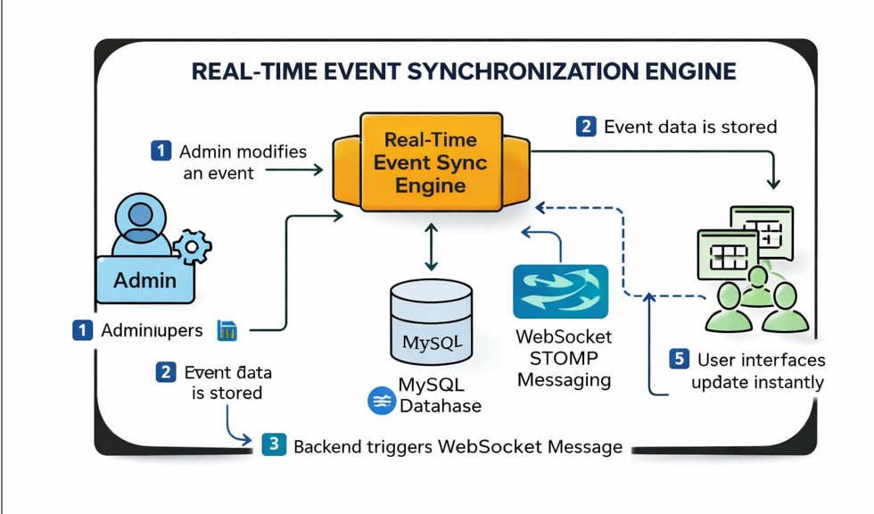
(Insert block diagram) -
Explain:
Input
Processing
Database
Output
PROPOSED SYSTEM ARCHITECTURE
1
2
3
4
5
6
7
8
9

Slide 7
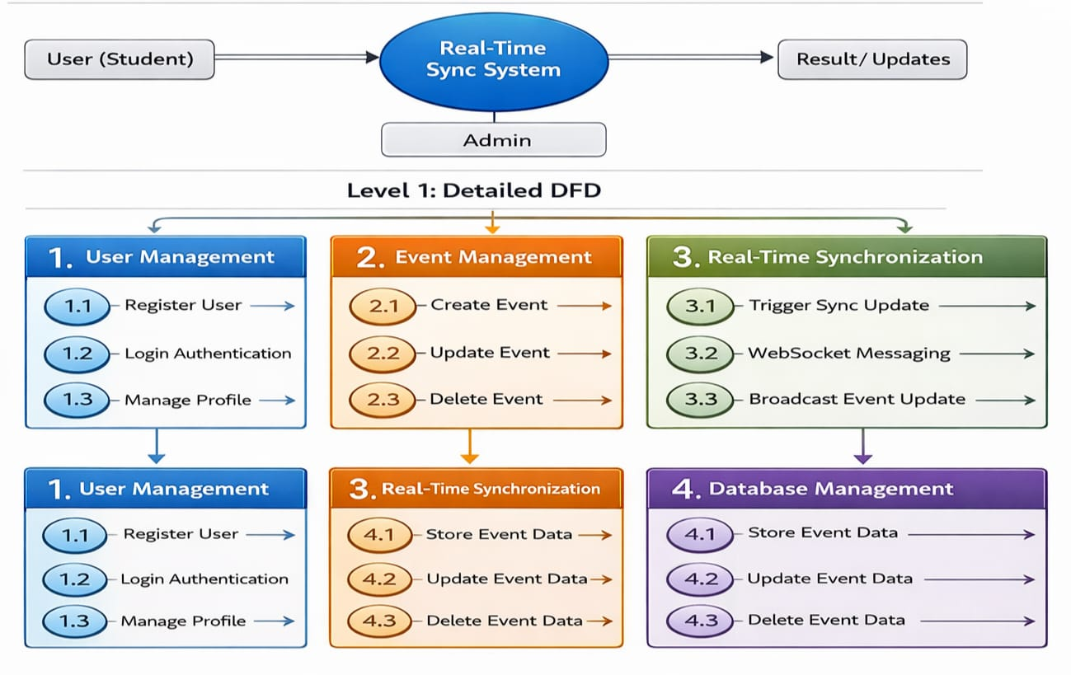
WORKFLOW
1
2
3
4
5
6
7
8
9

Slide 8
TECHNOLOGIES USED
Frontend:
1 . HTML5
2 . CSS3
3 . JavaScript
Backend:
1 . PHP
2 . MySQL
Tools:
1 . XAMPP Server
2 . Visual Studio Code
Software Requirements:
1 . Windows
2 . Web Browser
1
2
3
4
5
6
7
8
9

Slide 9
MODULE DESCRIPTION
Module 1: User Management
Handles user registration, login, and authentication.
Module 2: Core Event Management
Allows Admin to create, update, and delete events.
Module 3: Real-Time Synchronization Module
Uses WebSocket to send event updates instantly to all users.
Module 4: Database Management
Stores event details and user information securely.
1
2
3
4
5
6
7
8
9

Slide 10
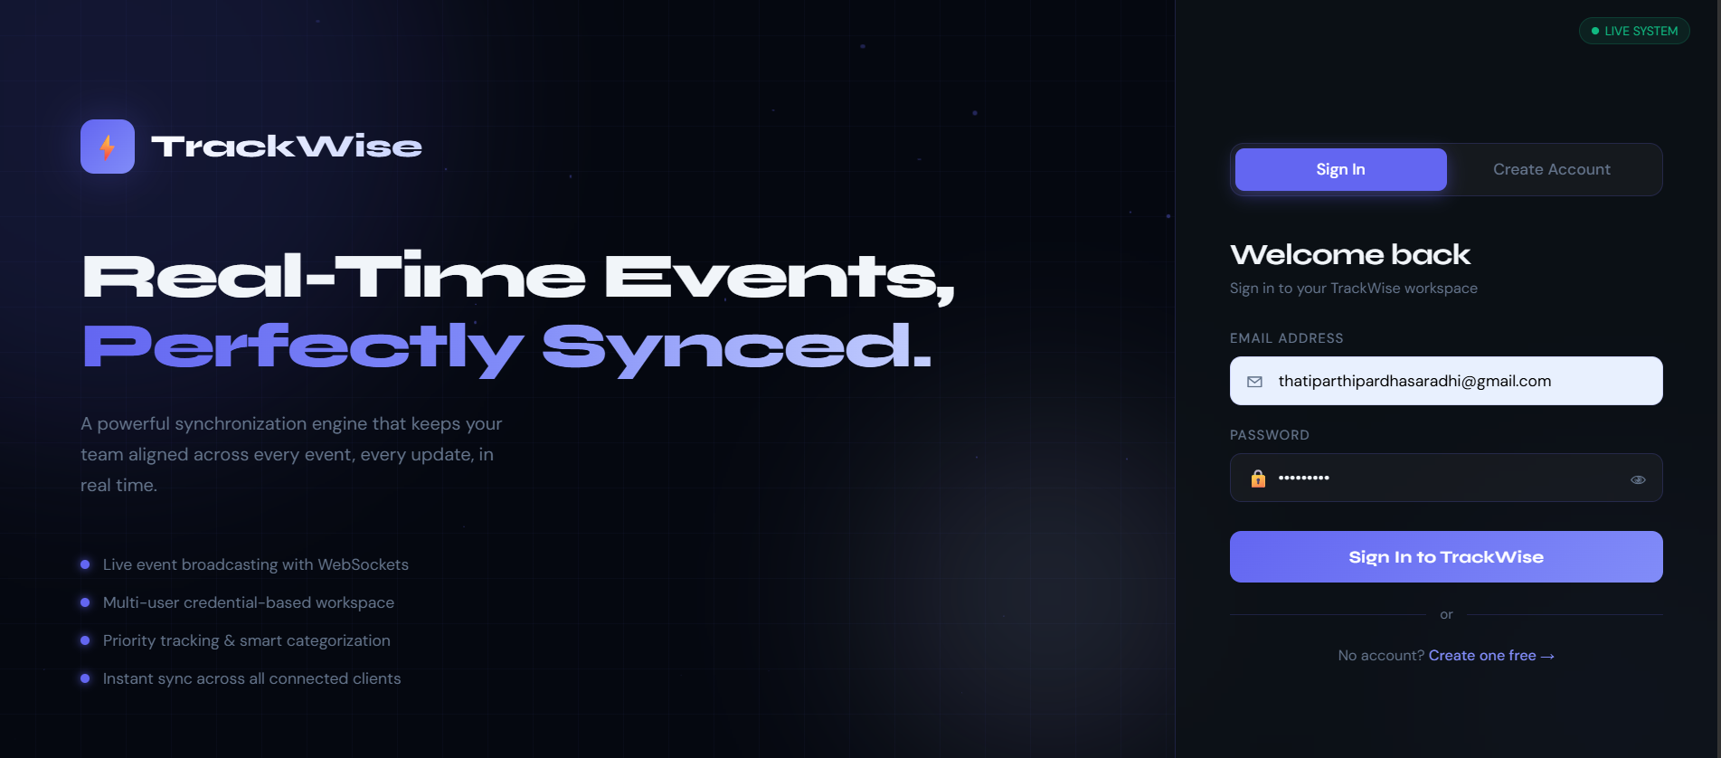
IMPLEMENTATION SCREENSHOTS
1
2
3
4
5
6
7
8
9

Slide 11
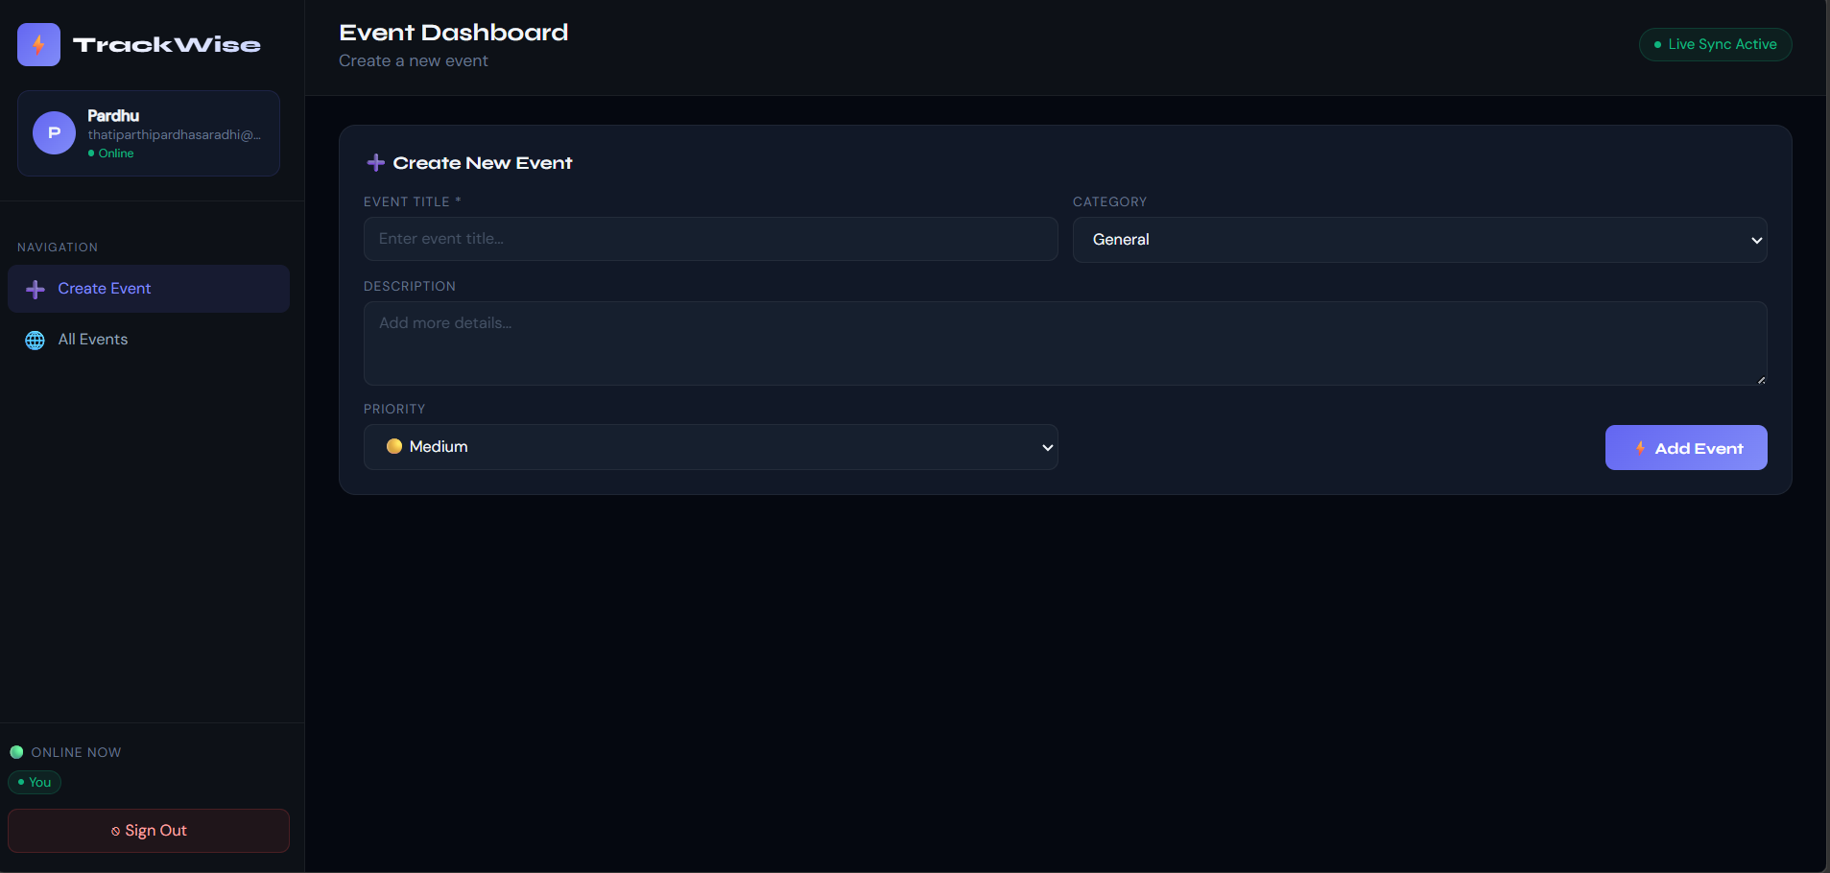
IMPLEMENTATION SCREENSHOTS
ADMIN PERSPECTIVE
1
2
3
4
5
6
7
8(A)
9

Slide 12
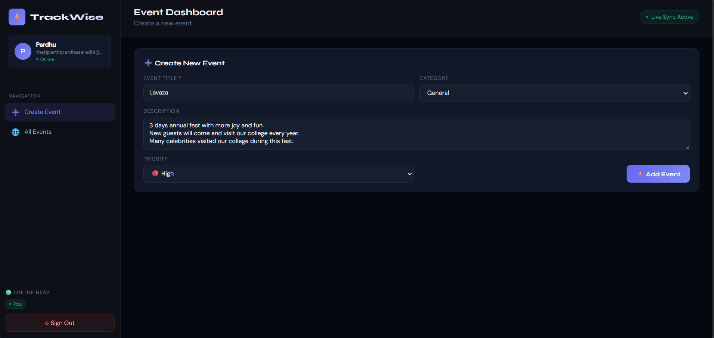
IMPLEMENTATION SCREENSHOTS
ADMIN PERSPECTIVE
1
2
3
4
5
6
7
8(B)
9

Slide 13
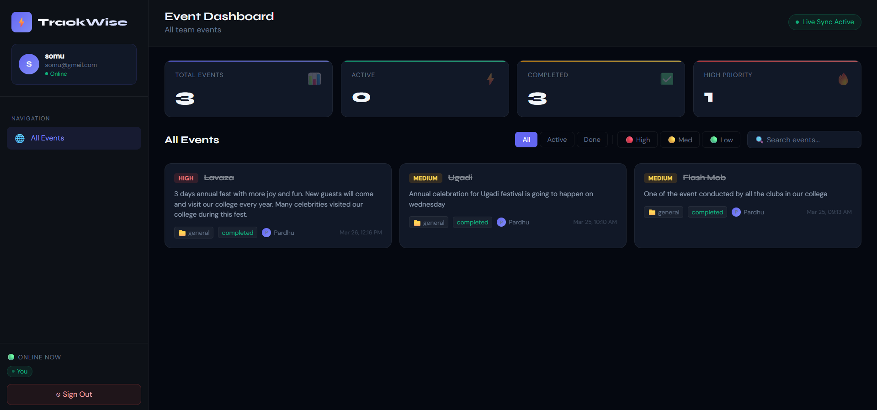
IMPLEMENTATION SCREENSHOTS
USER PERSPECTIVE
1
2
3
4
5
6
7
8(C)
9

Slide 14
ADVANTAGES & LIMITATIONS
1
Advantages:
1 . Instant Event Updates.
2 . No Manual Page Refresh.
3 . Prevents Scheduling Conflicts.
4 . Improved User Experience.
5 . Scalable System.
Limitations:
1 . Requires Stable Internet Connection.
2 . WebSocket Configuration Complexity.
3 . Security Challenges in Real-Time Systems.
4 . Server Load Handling Required.
2
3
4
5
6
7
8
9

Slide 15
Thank you

